Slide 1
Software Engineering
Module 6
Software Design - Concepts and Principles
Dr. Shai Koenig
Open University
Department of Computer Science

Slide 2
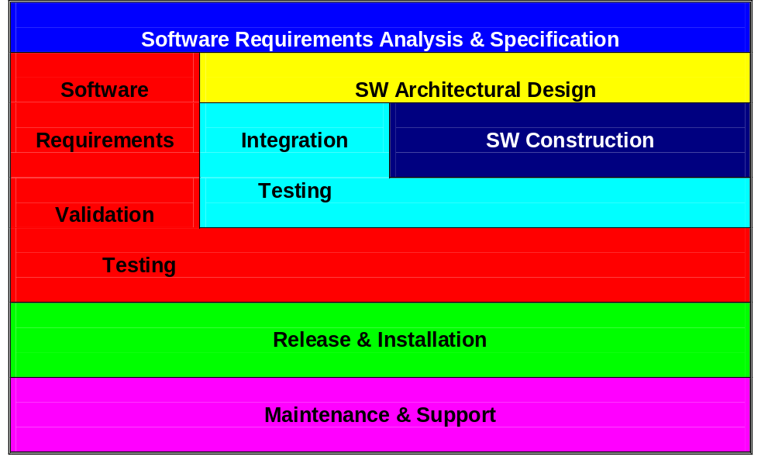
Software Design in context
Notes:
4
9
Notes
This slide suggests some of the temporal relationships between the key development activities.
For example, requirements precedes design which precedes construction, validation testing (at least the planning) overlaps with design, construction and integration, integration overlaps with construction, etc.

Slide 3
Framework for software development activities
Inputs
Basic concepts
Principles
Process
Techniques
Tools
Problems
Software
Development
Activity
Outputs
Verification

Slide 4
Documenting the software development process
- The Software Engineering Process Matrix
 | WORK-PRODUCTS · specifications · descriptions · drawings · source code - … | WORK-PRODUCT DEVELOPMENT PRATICES · procedures · standards · techniques · tools | SW QUALITY ASSURANCE PRACTICES · wp evaluations · process assessments · internal auditing - corrective action | WORK-PRODUCT CONTROL PRACTICES · document control · source control · version control · change control
Software Requirements
Architectural Design | X | X
Software Construction
Integration
Validation testing
Release & Deployment
Maintenance & Support

Slide 5
Topic to be covered
Introduction
  Need for design
  Objectives of software design
  Attributes of a software design
  The challenge of software design
Fundamental principles of software design
Software design processes
  Decomposition
  Composition
  Canonical
  Synthetic
Design work-product
  SW design description - users and uses
  Contents of a SW design description
Development techniques

Slide 6
Topic to be covered
Introduction
Fundamental principles of software design
Software design processes
Design work-product
Development techniques

Slide 7



Need for Design
Requirements
6 rooms
2 bathrooms
170 sq meters
central air conditioning
cost <= 150,000$
Construction

Slide 8

Need for Design
Requirements
6 rooms
2 bathrooms
170 sq meters
central air conditioning
cost <= 150,000$
Design - the bridge between requirements and construction
Construction

Slide 9
Objectives of Software Design
To produce a set of specifications [blueprints] that describe the software
  as it is to be implemented
  while it is being implemented
  as it has been implemented

Slide 10

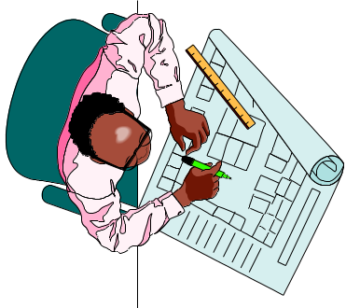
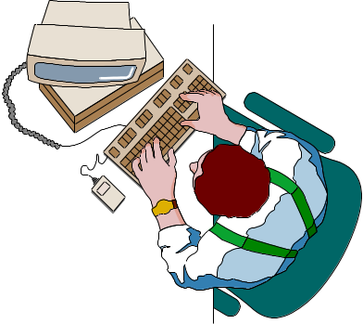
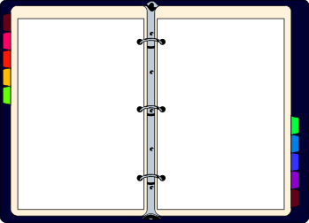
Objectives of Software Design
To produce a set of specifications [blueprints] that describe the software
  as it is to be implemented
  while it is being implemented
  as it has been implemented
Software
Design
SDS
SRS
Software
Construction
software
design
software
construction &
maintenance

Slide 11
Attributes of a Software Design
  provides all required functionality
  meets all required constraints
    behavioral
    resources
  be “easily” implemented
    verified, coded, integrated, tested within available resources
    complete and comprehensible
    as simple as possible but no simpler
  be “easily” maintained
    isolates aspects that are like to change
    facilitates fault location and correction
  provides for reusability
    intra-project
    inter-project

Slide 12
The challenge of software design
Software complexity
product complexity
  parts
  connections
  ad-hoc, unstructured
  versions
  details
process complexity
  participants
  time
  conflicting goals
  fluidity
    requirements
    technology
    people

Slide 13
The challenge of software design
Software complexity
product complexity
  parts
  connections
  ad-hoc, unstructured
  versions
  details
process complexity
  participants
  time
  conflicting goals
  fluidity
    requirememts
    technology
    people
The Hrair Limit
the number of entities humans can process at one time is roughly 7 + 2
this is a fundamental human limitation
humans are unable to simultaneously deal with all the elements, attributes relations and implications of a complex situation
G.A. Miller
The Magical Number Seven, Plus or Minus Two: Some Limits on Our Capacity for Processing Information
Psychological Review, Vol. 63, March 1956.

Slide 14
The beginning of wisdom for a programmer is to recognize the difference between getting a program to work and getting it right.
Michael A. Jackson 1975
We try to solve the problem by rushing through the design process so that enough time will be left at the end of the project to uncover the errors that were made because we rushed through the design process...
G. Myers - 1978

Slide 15
Topic to be covered
Introduction
Fundamental principles of software design
Software design processes
Design work-product
Development techniques

Slide 16
Fundamental Principles of SW Design
Modularity
  “The separation of the idea into parts, by dividing it at the joints...”
  Plato, Phaedrus, 265D
  “Divide and conquer”
  Julius Caeser, 1st century, B.C.E.
Iteration
  to conquer - “divide and conquer”
  procedure CONQUER is
  DIVIDE
  CONQUER
  end procedure
Basic strategy for problem solving

Slide 17
Modularity Criteria
High Cohesion
  A module should deal with a single “subject” [e.g., function, data, device, algorithm, ...]
Weak Coupling
  when modules communicate, they should exchange as little information as possible
Minimal Interfacing
  keep the number of
  inter-module interfaces as low as possible
Information Hiding / Abstraction
  a module should hide as much information as possible and expose only what is needed by its clients

Slide 18
Questions to be discussed
What are the units of software modularity ?
How do modules interact ?
How do we decompose into modules ?
  guidelines for decomposition
How do we compare different decompositions ?
  criteria for judging a decomposition

Slide 19
Topic to be covered
Introduction
Fundamental principles of software design
Software design processes
Design work-product
Development techniques

Slide 20
Software Design Processes
Composition
the use of existing “building block” components to build more complex components which are themselves used to build higher level components
Decomposition
iteratively decomposing a component into a number of interacting subcomponents, until we arrive at a level of components appropriate for implementation
Canonical
the use of existing design templates for well-understood problem domains
Synthetic
the ues of a combination of
these design processes

Slide 21
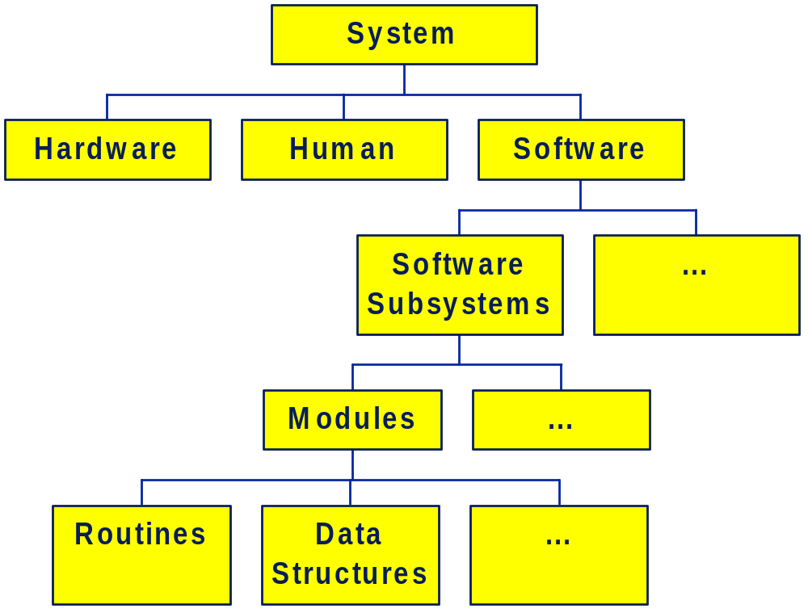
Software Design Processes
Decomposition
Composition
Canonical
Synthetic

Slide 22
Software Design Processes
system design
architectural design
database design
detailed design

Slide 23
System Design
Decomposes System into
  special purpose HW
  standard processing elements
  off-the-shelf software
  special purpose software
  manual components
Deals with
  operating concept
  HW/SW allocation
  HW selection
  distribution
  communication infrastructure
  reliability, back-up, recovery
  performance
  virtual machine

Slide 24
Software Architectural Design
Decomposes software into
  processing subsystems
  database subsystems
  modules
    packages
    tasks
    classes
  interfaces
Deals with
  distribution
  concurrency & synchronization
  persistent data
  communication
  reliability, back-up, recovery
  performance
    time
    memory
    capacity
  infrastructure
    operating systems
    communications
    dbms
    general purpose packages

Slide 25
Software Detailed Design
Decomposes modules into
  routines
  global data structures
Deals with
  internal design of modules
  inter-procedural communication
  algorithms
  data structures

Slide 26
Data Base Design
Conceptual data base design
  entities
  attributes
  relationships
  operations, transactions
Logical data base design
  relations
  constraints
Physical data base design
  DBMS selection
  indices
  file structures

Slide 27
Data Base Design
user
requirements
specification
SRS
Requirements
analysis and
specification
conceptual
database
design
ER Model
Translate requirements
into conceptual schema of the database
Normalized
candidate
relations
logical
database
design
Transformation of the conceptual schema into a logical schema using the implementation data model
physical
database
design

Slide 28
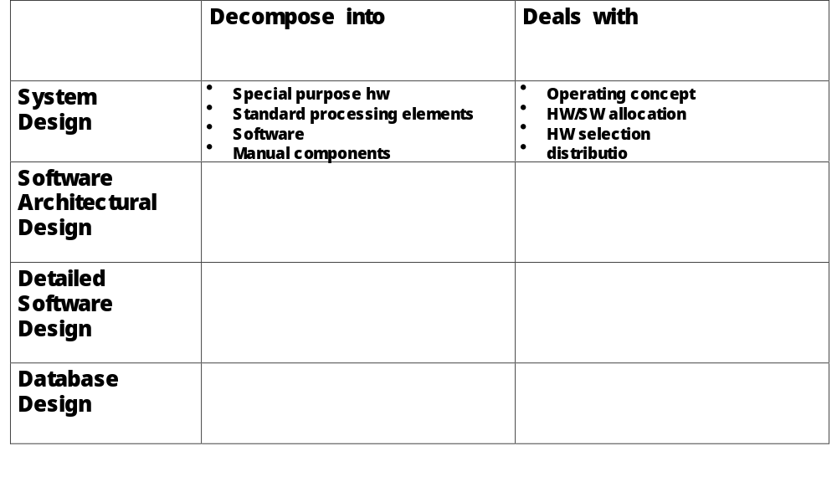
Design levels

Slide 29
The decomposition process
architectural
design
decomposition into subsystems and modules
interface definition
persistent data design
virtual machine
detailed
design of
modules
detailed
design of
routines
decomposition into routines
define their interfaces
call structure
global data structure
Decomposition
Composition
Canonical
Synthetic
data definitions
algorithms
pseudo-code

Slide 30
The decomposition process
Advantages
based on “divide and conquer” paradigm
incremental addition of detail
enables delaying design decisions
understanding and design evolve together
facilitates multi-person development
almost always used in early stages of design
Disadvantages
important decisions made early in the process
duplication of low level components
unclear when to stop decomposing
identified with functional decomposition

Slide 31
Decomposition
Composition
Canonical
Synthetic

Slide 32

Composition
Decomposition
Composition
Canonical
Synthetic
compose software from existing elements
bottom-up
highly cost-effective [when it works]
requires a suitable framework, e.g.,
  Unix [pipe and filter architecture]
  Windows
  Lisp

Slide 33
The composition process
Advantages
often used in design of “virtual machine”
fosters re-usable components
highly cost effective, when it works
encourages more investment in quality
avoids duplication of low level components
Disadvantages
“it’s hard to build a bridge when you don’t see the other side”
depends more on intuition, judgement and experience
harder to use in multi-user environments

Slide 34
Canonical Design
Decomposition
Composition
Canonical
Synthetic
for certain domains, “good” designs exist and are well-known
useful form of reusability [architectural vs component reusability]
examples
  compiler design
  ISO OSI 7 tier communications architecture
  GUI’s
application generators are often useful in such application domains
highly cost-effective

Slide 35
Example of Canonical Design - Compiler Design
Lexical Analysis Subsystem
Syntax Analysis Subsystem
Table
Management
Intermediate Code Generation Subsystem
Error
Handling
Code Optimization Subsystem
Code Generation Subsystem

Slide 36
Synthetic Approach
Decomposition
Composition
Canonical
Synthetic
combine decomposition, composition and canonical approaches
  composition for the virtual machine and software infrastructure
  decomposition for less understood application areas
  canonical design for well-understood domains

Slide 37
Synthetic Approach
Decomposition
Canonical
MMI
DBMS
Composition
file system
comm system
utilities
operating system
computer hardware

Slide 38
Topic to be covered
Introduction
Fundamental principles of software design
Software design processes
Design work-product
Development techniques

Slide 39




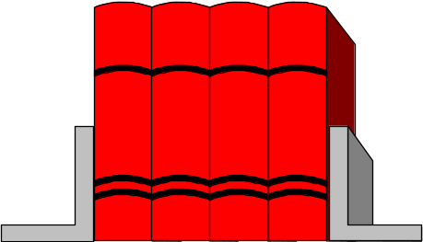


SW Design Description - Users and Uses
Basis for project
planning and tracking
Basis for
designer to designer
communication
Basis for
construction and
evolution
Software
Design
Specification
Basis for design verification
Basis for integration testing

Slide 40
Contents of the SW Design Description
Introduction: scope, context, terminology, references
Infrastructure: HW, Operating Systems, DBMS’s, Comm SW
Static structure - Decomposition into components and interfaces
  for each component: function, interfaces, resources
  for each interface: mechanism, contents
Dynamic [Uses] structure
Process structure
Persistent data
  contents
  mechanisms
Data dictionary
Design Scenarios [interactions]
Rationale, alternatives considered
Requirements compliance and traceability

Slide 41
SW Design Description Standards
DOD Std 2167A - Data Item Definitions
DOD Std 498 - Data Item Definitions
IEEE Std 1016-1987 - IEEE Recommended Practice for Software Design Descriptions
IEEE Std 1016.1-1993 - IEEE Guide to Software Design Descriptions
“Nohal Mafteach”, Israel finance ministry, Methoda Ltd.

Slide 42
the relationship between the SDS and source code
software
construction &
maintenance
software
design
reverse
engineering
SDS
code
Software
Design
manual
updating
Software
Construction
forward
engineering

Slide 43
Topic to be covered
Introduction
Fundamental principles of software design
Software design processes
Design work-product
Development techniques

Slide 44
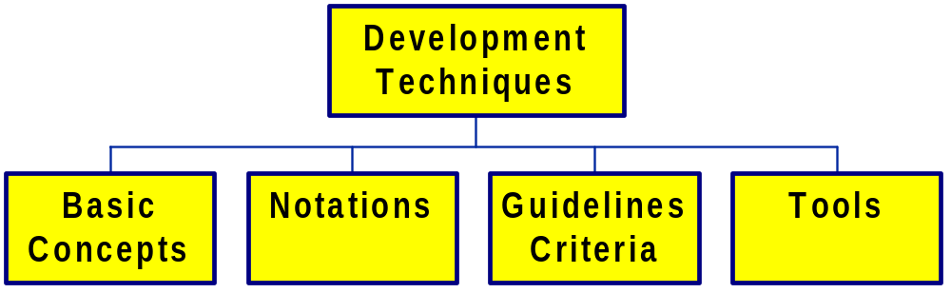
Development Techniques

Slide 45
Development Techniques
a conceptual framework for development
a common vocabulary
for expressing design decisions
for representing development work-products
how to use the concepts and notation
how to assess the work-product
assistance in making design decisions
for automating application of the development technique
for automating enforcement of rules

Slide 46
Development Techniques
By relieving the brain of all unnecessary work, a good notation sets it free to concentrate on more advanced problems.
Alfred Whitehead
An Introduction to Mathematics

Slide 47
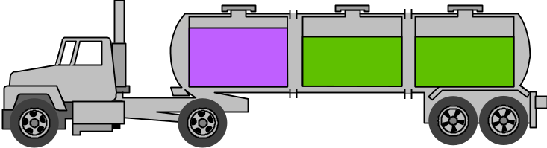
The role of automated tools & environments
Techniques
Process
Basic Concepts
Notations
Guidelines, criteria
Tools &
Environments
Techniques
Process
Basic Concepts
Notations
Guidelines, criteria
Tools &
Environments

Slide 48
Development Techniques
Entity Relationship Modeling
Use Cases and Interaction Diagrams
Statecharts
Structured Analysis
Structured Analysis/RT
SW Architecture Styles
Object-based design approaches
Object-oriented design approaches
Design patterns
Structured Design
...

